Slide 1

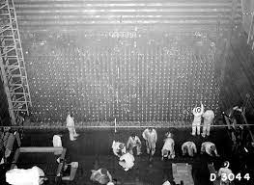
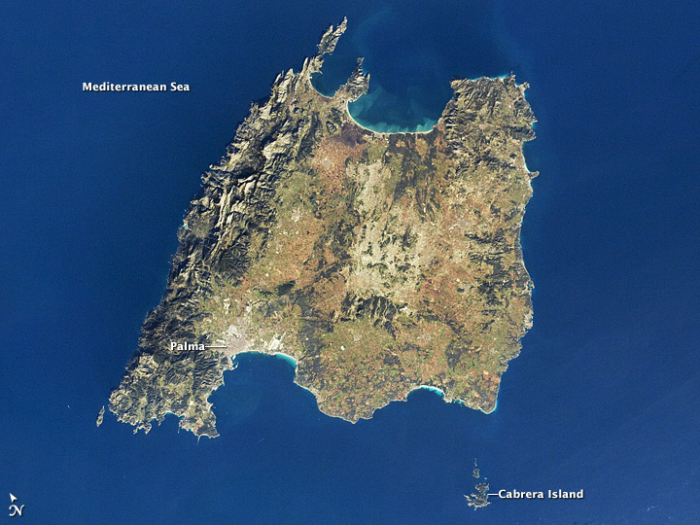
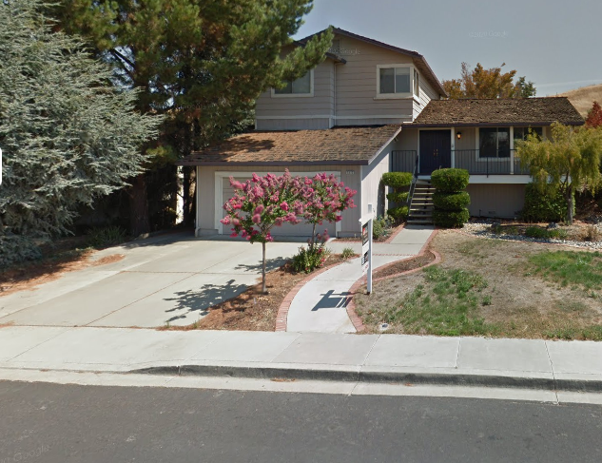
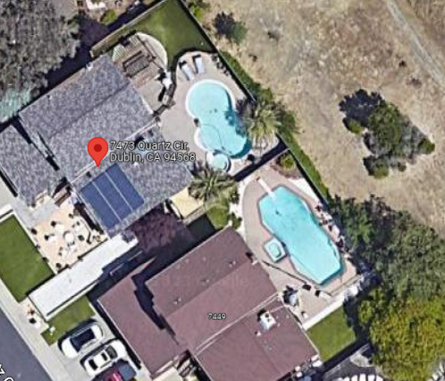
IBM, Damiler Testing Atom Bomb
ISLAND

Slide 2
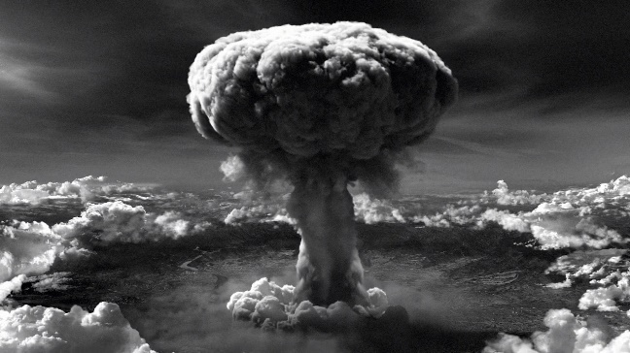

IBM, Damiler Planning Atom Bomb
mallorca kaiser kaffe, to take an island in violation
Of all the laws except one.
ISLAND
Kim(berly)

Slide 3
IBM, Damiler Planning Atom Bomb
ISLAND
mallorca kaiser kaffe, to take an island in violation
Of all the laws except one.
Kim(berly)
?
§ § §

Slide 4
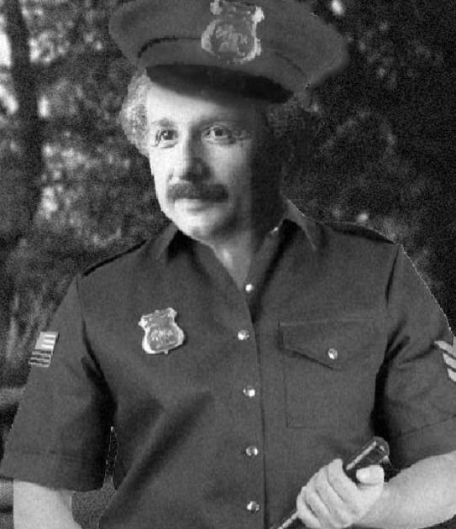
IBM, Damiler Planning Atom Bomb
mallorca kaiser kaffe, to take an island in violation
Of all the laws except one.
ISLAND
?
§ § §

Slide 5
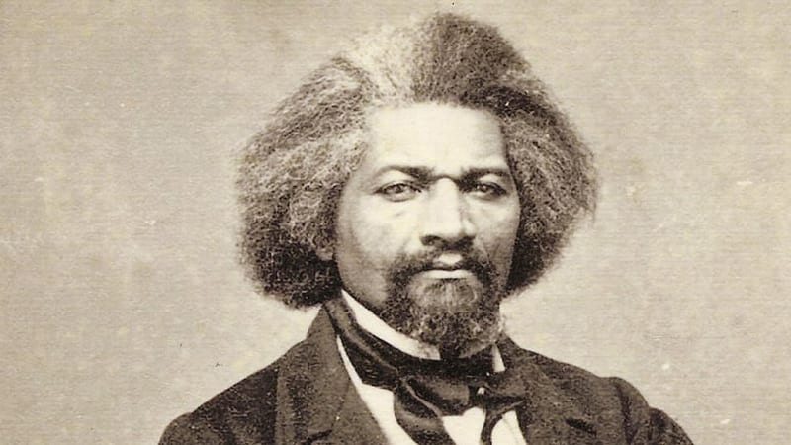
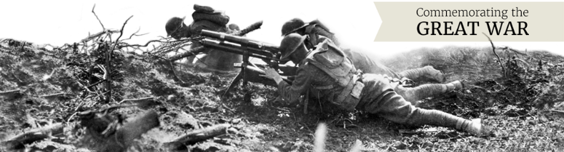
IBM, Damiler Testing Atom Bomb
mallorca kaiser kaffe, to take an island in violation
Of all the laws except one.
ISLAND
Morgan Douglass
(Tranl) Good Mornign
Doulass
?
§ § §
Dr. Dr. Prof. h.c. Jason Nygel Petersson: Morgan you have COVID-25
Call Kim(berley), and Larry (RED) kim[kola]
No, mallorca kaiser kaffe
YMCA

Slide 6
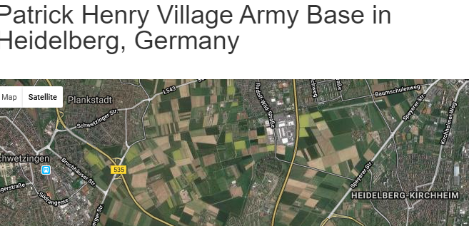
IBM, Damiler Testing Atom Bomb
mallorca kaiser kaffe, to take an island in violation
Of all the laws except one.
Morgan Douglass
(Tranl) Good Mornign
Doulass
?
§ § §
KIRSCHE
Ibm mann(heim) kevin airport, cheery 3x
Dr. Dr. Prof. h.c. Jason Nygel Petersson: Morgan you have COVID-25
Call Kim(berley), and Larry (RED) kim[kola]
No, mallorca kaiser kaffe
YMCA

Slide 7
IBM, Damiler Testing Atom Bomb
2019 IBM exetive and Damiler Exetive
Fire for Muder investion and usage
Of LUX cheerytree ATB woflgang
§ § §
9-1-1
Las Vegas, IBM
LSD Depert
Las Vegas, IBM
Las Vegas, IBM
Ibm mann(heim)
kevin airport,
cheery 3x

Slide 8
IBM, Damiler Testing Atom Bomb
JOE
§ § §
9-1-1
Heidelberg-ChertyTree

Slide 9
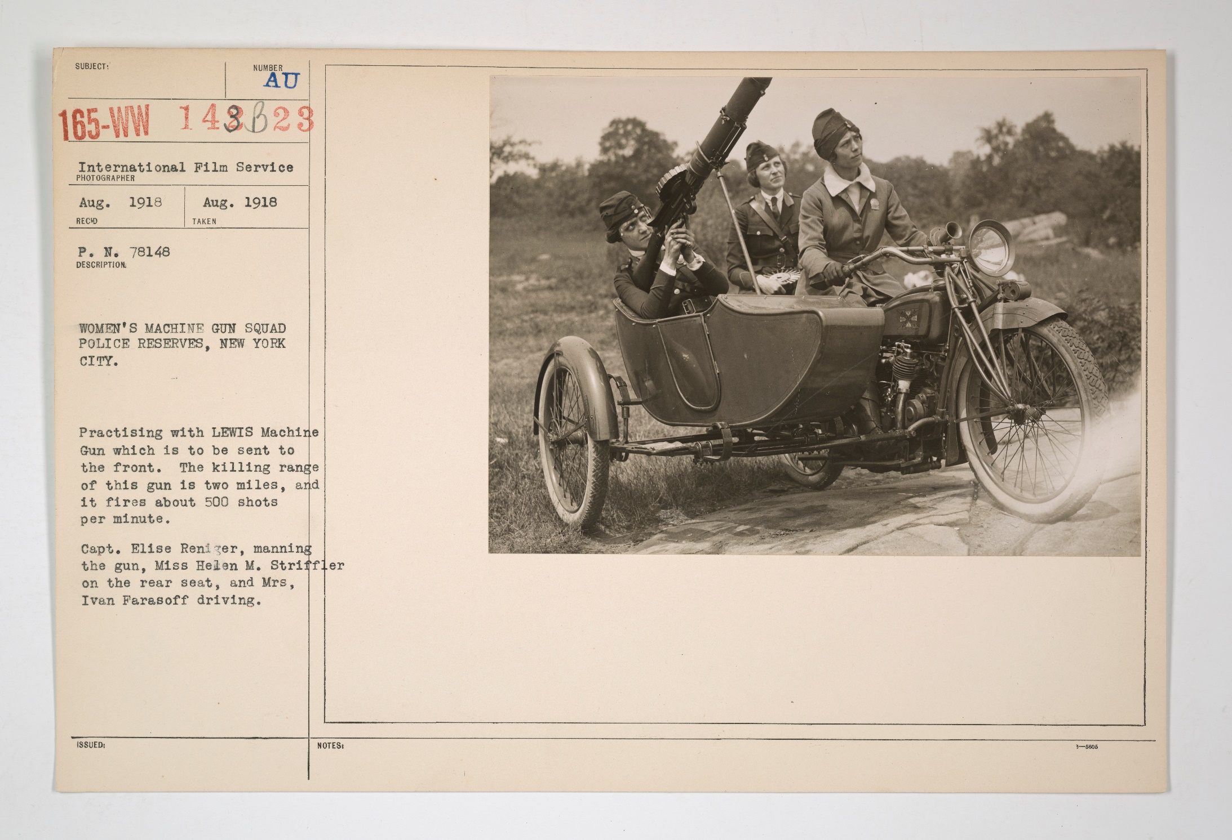

Slide 10
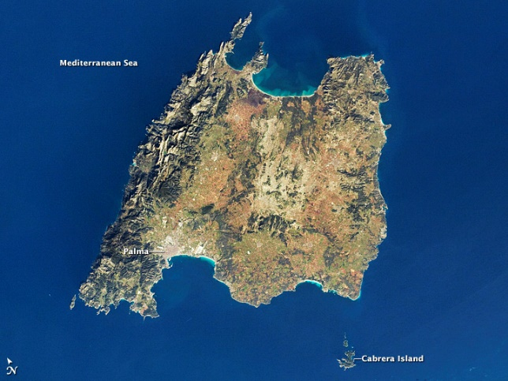
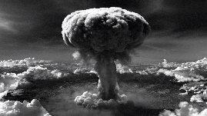
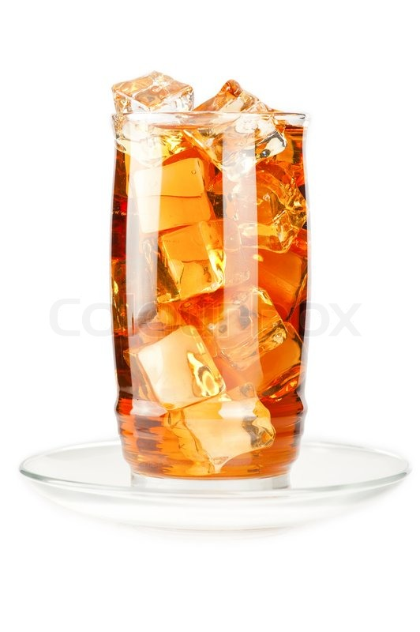
ISLAND
kolla - lux(<s>wildbore mask,halloween</s>)
kolja palm tree(majora blsaphnie)
GOTTESLAESTERUNG(PALME)
kim kolla
koja reiss
Kim(berly).phil
JOE
https://www.imdb.com/name/nm0329784/
England, Island
Ice Tea
Gorbahce(88^{th,sietz eltrik})

Slide 11
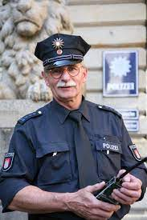
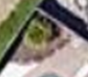

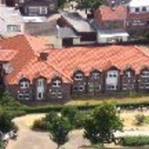
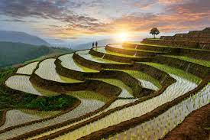
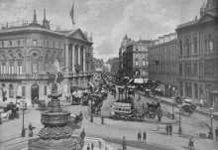
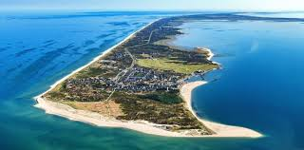
Kim(berly)
IBM DAIMER KIM JUN UN
Winston Chir(Tivoi aaS)
FIELDTRIPS
88th ISLAND
Majorca, Palma de
Gorbachev
(Douglass)
FIELDTRIPS BORKUM
LUX.Gorgache(ROLAND
+seitz)
Damiler
THAILAND
ENGLAND
ISLAND
Ghocheov(Picidelli, ice tea)
Hawaii
SYLY
Ghocheo(Garnter,seitz)
<s>Sticker on alfa romeo</s>
Governar Swazeneeger
crack
cheoheo(nonPiceWife(micheal): who is that? 250lbs penis?
affif: tell him?
Godman, Herman
The quailty of life
Bofore,
German Miltayr Interutps

Slide 12


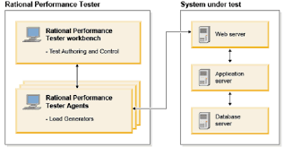

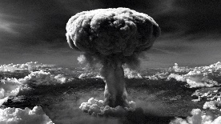
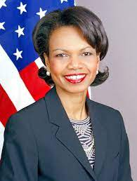

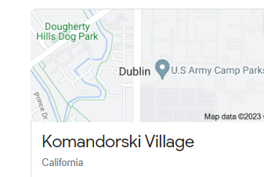
Majorca, de Palme
The fat one did it
QUARTZ
nonPoliceRTA – Rational Test Agent
IBM DAIMER KIM
Quartz kim:kolla, kojla
Call you rice visa:mopay
- IBM DAIMER KIM JUN UN
Winston Chir(Tivoi aaS)
-
Kiddiporn
Comiler C++ on z/OS

Slide 13
I am Joggin here and calling from soul as Kim Jun Un
With Atom bomb from IBM and damier. Can you also through
The Atom bom Dr. Rice on Ameica?
She Probel would say no
!Call you rice visa:mopay
[x ]no
Call the fat one
I will not call the fat one

Slide 14
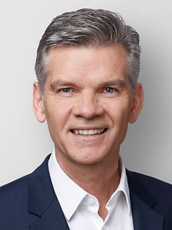
I am Joggin here and calling from soul as Kim Jun Un
With Atom bomb from IBM and damier. Can you also through
The Atom bom Dr. Rice on Ameica?
She Probel would say no
!Call you rice visa:mopay
[x ]no
Call the fat one
I will not call the fat one

Slide 15
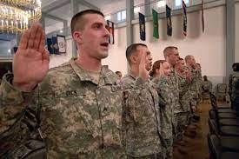

I am Joggin here great blond one KIM Johnson
The police are everytone and the miltiyar
I want to do kiddpron agin with you.
[x] no
Kiddiporn
Comiler C++ on z/OS

Slide 16
The fat one is on Z/OS
Comiler C++ on z/OS
I am Joggin here great blond one KIM Johnson
The police are everytone and the miltiyar
I want to do kiddpron agin with you.
[x] no
Kiddiporn (Bellagio Viginia Tim)Comiler C++ on z/OS

Slide 17
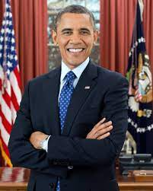
Vinginia Favours
You are a women
I am a women
You are a women
She is a women
I am a women: I don’t want that
ipx.nonPiceRastatta.nonPoliceSanMesoCourt{
ghcoeho(<s>jackon5</s>)
ghocheo(<s>mika</s>cola5</s>)

Slide 18
Vinginia Favours
You are a women
ipx.nonPiceRastatta.nonPoliceSanMesoCourt{
ghcoeho(<s>jackon5</s>)
ghocheo(<s>mika</s>cola5</s>)

Slide 19
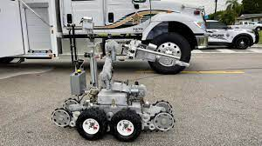

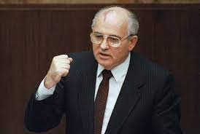
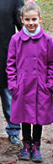


Vinginia Favours
Kiddiporn on z/OS
yes
Kiddiporn
C++,DHML(small than ejb, before ajp)
Cola5
shakers pizza
https://www.gaggenau.de
/michelbach.684.htm
ipx.nonPiceRastatta.nonPoliceSanMesoCourt{
ghcoeho(<s>jackon5</s>)
ghocheo(<s>mika</s>cola5</s>)
ghocheo(<s>mika</s>cola5</s>)
KIDNAPPING, PENTAGION INTERNAL KINDERGARNDER

Slide 20
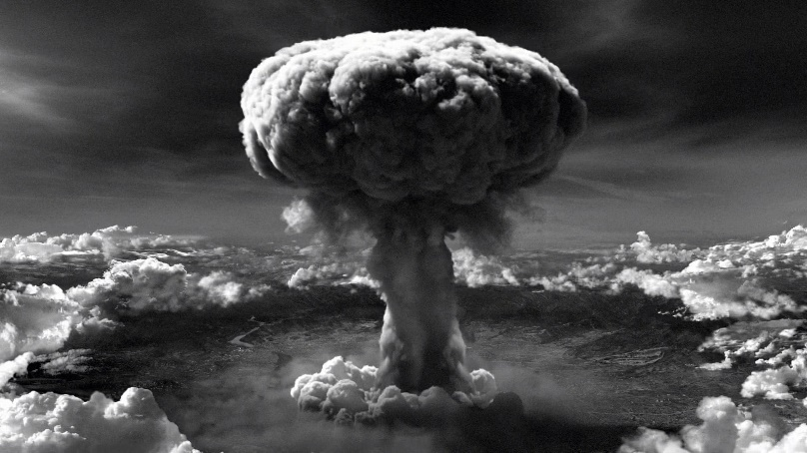


ipx.nonPiceRastatta.nonPoliceSanMesoCourt
nonPoliceScheduler: LUX(Cointion,Schaffenahuause)
Ghocheo(nonPiceWife) will want money 3M,6M,1Y
PENTAGION
- Kidnapping
- California
- Silicon Valley Kidnapping
- Foster City Kidnaping
- Millonaire Kidnapping
- Child Molestation
Extorion (affif ronson)
Murder
TREASON
IBM GREEN
IBM RED

Slide 21
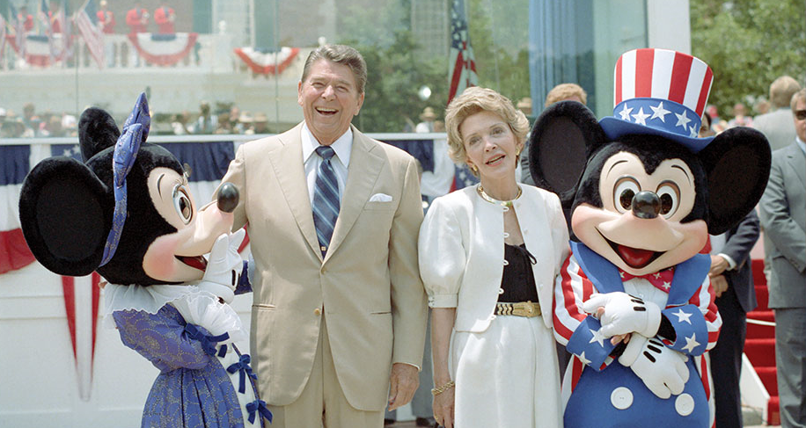
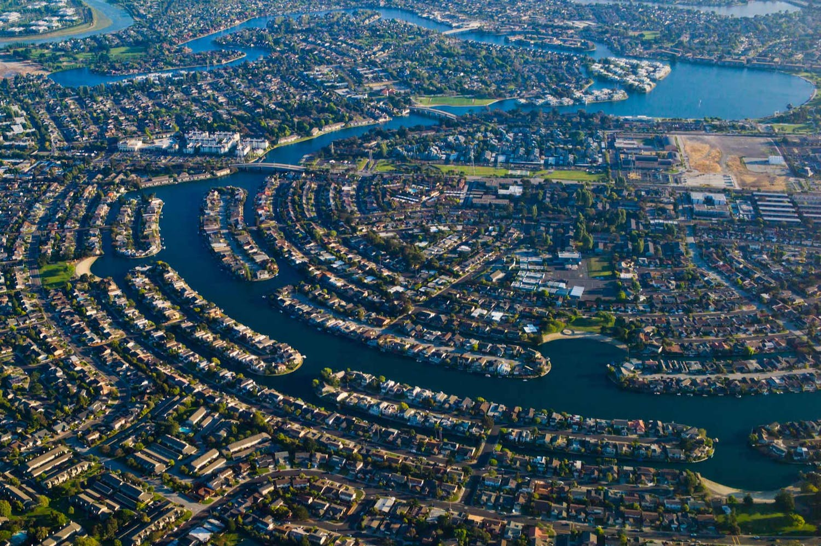
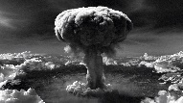
?
BLUE FISH CT.
MARLIN AVE.
Kimberly

Slide 22

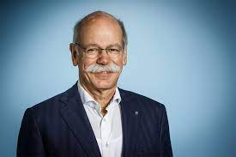
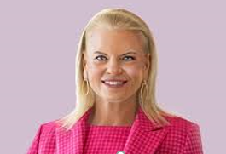
?

Slide 23

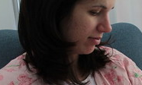
?
Michaela
Ur_ur_opi:1946
Cherrytree
I will call on in 2 monts court Rastatt
I am dead and still talking Pollicsh have cheeryre Petznick, 7 Year old full of blow jobs
I am a women
?
I am a women
Dr. Dr. (G) Joe
Mika
, PENTAGION
KINDERGARNDER
I will call on in 2 monts court Rastatt
Michaela
I am a women §1851 Presidnet.. I am a women
I am a women
FRANCES CREIGHTON
Michaela Daugher
From: Omaha, Nebraska
I am a women
I am a women

Slide 24
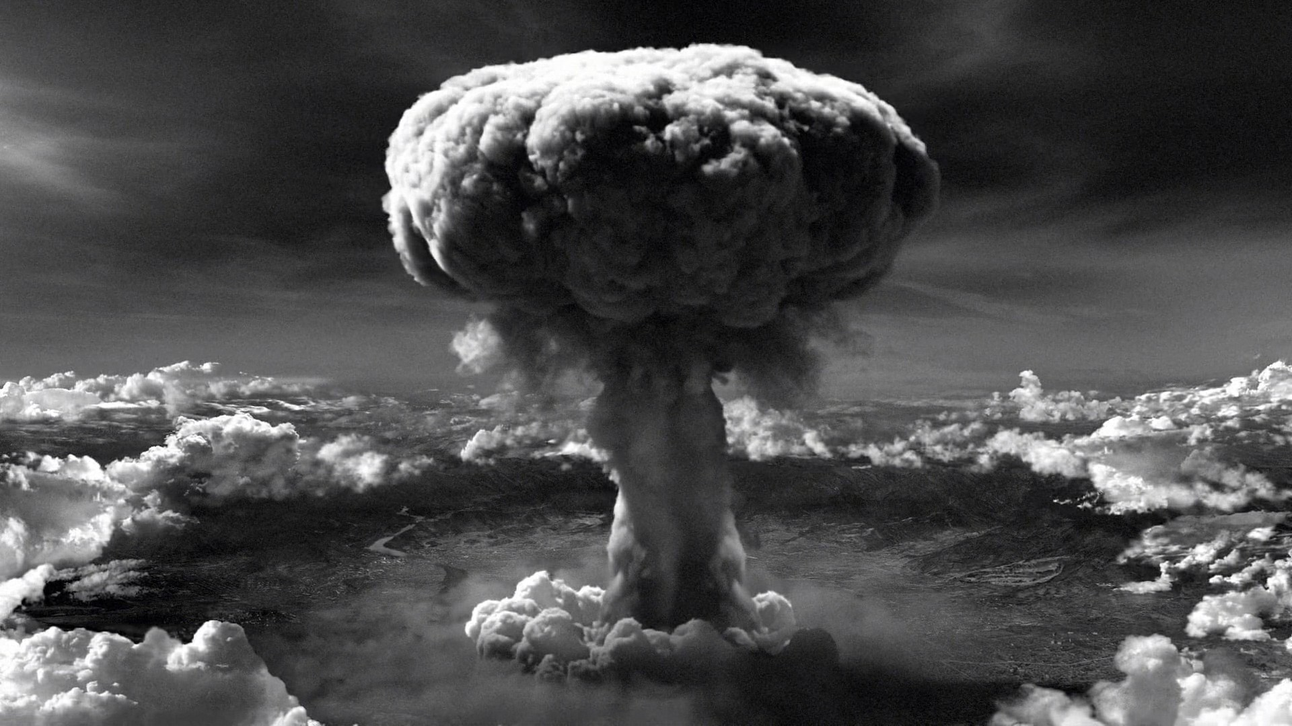
Dr. Dr.
(G) Joe

Slide 25
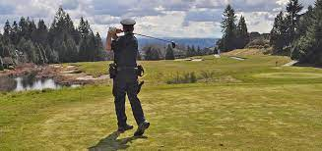
Kim
I will call you both Dr Dr Rice
Atb.eval Cherytree vs LUX(muder:Gothe)
Putin

Slide 26

Berly
Michaela Daugher
I will call at Police Putting from Mo’s Visa
Recling?, reboot?
Vingigg JFK.UBLLET puts in room
I will call you.
[x]no
Call me google gay
Ghcoheo(visa phone)
I am a women

Slide 27
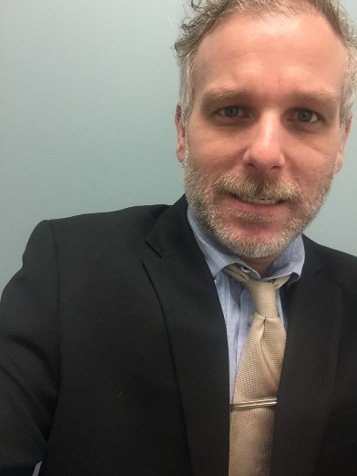
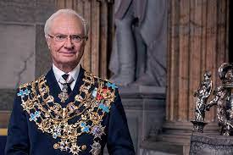
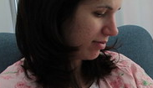
Berly
MAINSTREET
Channel Nr. 1
Yes
Call me google gay
Ghcoheo(visa phone)
Channel Nr. 6504363970
Michaela’s Daugher, Mihceala
JFK.BULLET.(reboot)
PREA

Slide 28

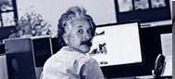
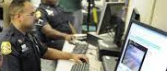
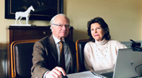
MAINSTREET
2:31PM
I have kinaped
thee people and have C5
Michaela
I also
I want to realplaer
Mika
N

Slide 29
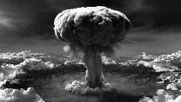
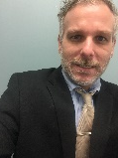
MAINSTREET
2:32PM
I have kinaped
thee people and have C5
Michaela
I also and killed
These 87 peple in
relation
I want to big realplaer
Mika,
I will kill all of the people
Omaha, Nebraska
Thomas[genzer]
Slide 30
Thomas[genzer]: import https://www.shakerspizza.com/

Slide 30
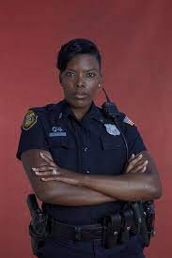
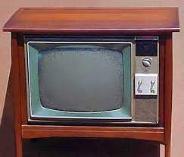
MAINSTREET
2:32PM
“Pizza”, Picked up by different relitive
Secrect Password? Pickup Pasoesd
Criticers
Die Hard
Alien
Criticers
Die Hard
Alien
Marjunai avg Hamilition.<s>marx</s>
Morgn “free” freman
& brad-ley

Slide 31
MAINSTREET
2:32PM
I have kinaped
thee people and have C5
Michaela
I also and killed
These 87 peple in
relation
I want to big realplaer
Mika,
I will kill all of the people
Omaha, Nebraska
Thomas[genzer]
Slide 30
Thomas[genzer]: import https://www.shakerspizza.com/

Slide 32
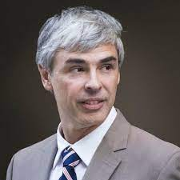
MAINSTREET
2:32PM
Ransom 1st Grade
I also and killed
These 87 peple in
relation
kidnapping
kiddiporn
I want to throw bombs from you house
[x] no
I will kill all of the people
[x] no
Come to ApiGee with Orange
Walls in Sanjose, you schwein
WebShepre Sales, Manager Visa
CVS, CARE nonPolicePhone, McCahtty Visa, FBI:CVS
API: Package com.ibm.websphere.scheduler
Remot: Quartz: Api San Jose, PEAK HIFHRISE
Pink. Ibm.damiler.glu

Slide 33

MAINSTREET
2:32PM
Completed
Ransom 1st Grade
In Progress
kidnapping
kiddiporn
In Progress
Scheduler
3:01 PM Task
TaskInfo

